Slide 1
Predicting Walmart Sales
Team 2
Neetu Rasinger Babu, Sri Mounika Jammalamadaka, Nikhil Gudur, Priya Khandelwal
Department Of Applied Data Science, SJSU
Data 230- DATA VISUALIZATION
Prof. Dr. Guannan Liu

Slide 2


Objective
Sales forecasting is important for retail efficiency;
Based on our findings of the dataset chosen
Walmart faces challenges in this area.
Walmart's dynamic market is influenced by customer behavior, seasons, and economic factors.
Project goals include understanding sales variables, creating a predictive model, and enhancing decision-making.
The initiative combines data science to improve Walmart's sales forecasting, optimizing inventory and marketing strategies.
The project aims to provide valuable insights for sustaining Walmart's competitive edge in the retail market.
DATA-230 Project Presentation
Predicting Walmart Sales

Slide 3
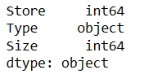
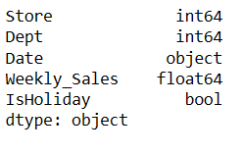
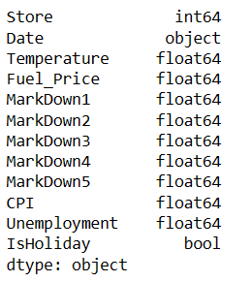
Dataset
Data Source - Kaggle
Consists of 3 files that are merged into a single dataframe
Stores Data Departments Data Sales data
Data Shape (45, 3) Data Shape (421570, 5) Data Shape (8190, 12)
Data Shape (8190, 12)
DATA-230 Project Presentation
Predicting Walmart Sales

Slide 4
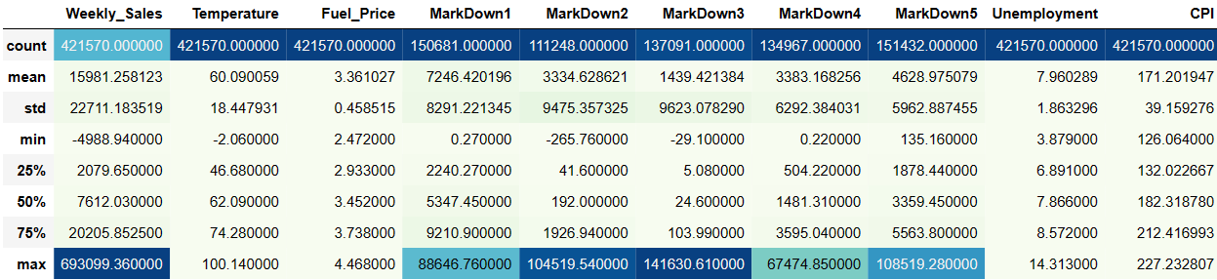
Dataset (Statistics of dataset)
DATA-230 Project Presentation
Predicting Walmart Sales

Slide 5
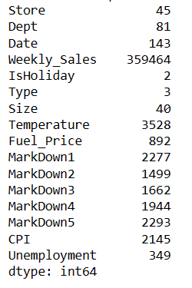
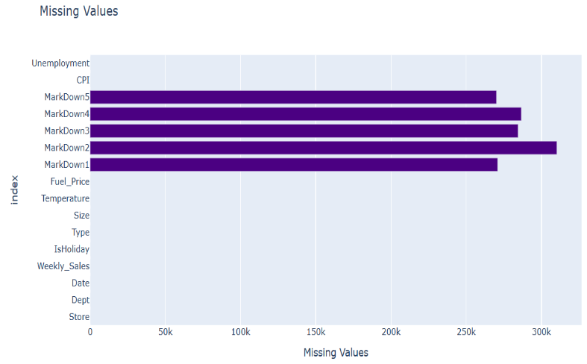
Data Exploration
Duplicate Values : 0
Missing values :
Unique values:
DATA-230 Project Presentation
Predicting Walmart Sales

Slide 6
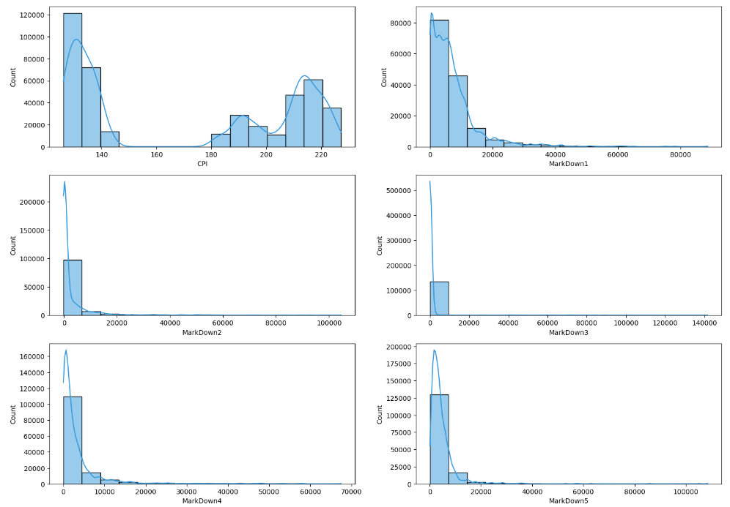
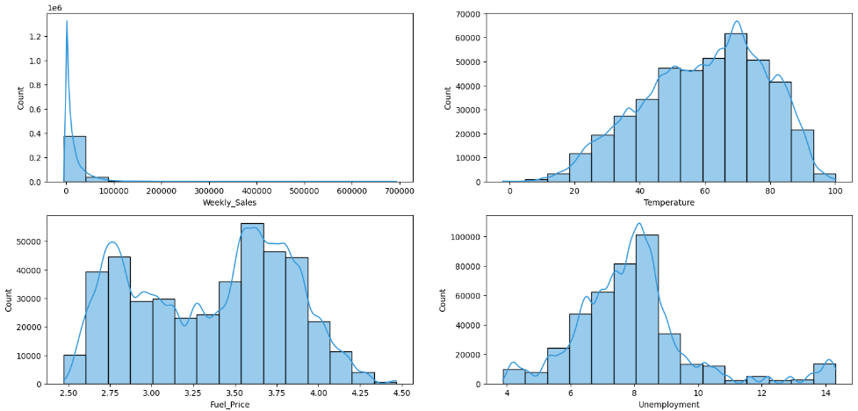
Exploratory Data Analysis
Histogram for Numerical Features
The distribution of Weekly_Sales is right skewed, this is normal because the weekly sales may be high in some time.
Temperature and Unemployment have normal distribution.
CPI and Fuel_Price have bimodal distribution.
DATA-230 Project Presentation
Predicting Walmart Sales

Slide 7
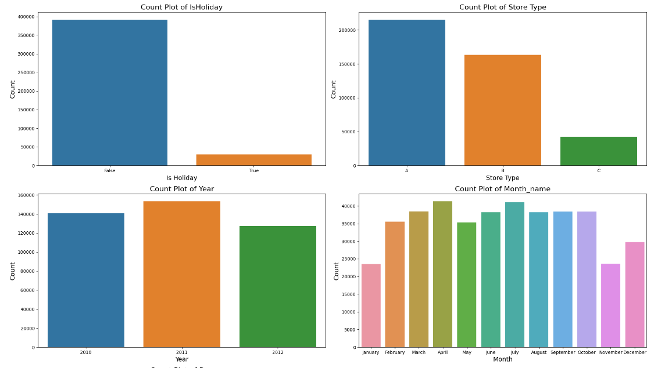
Exploratory Data Analysis (Count Plot For Categorical Features)
DATA-230 Project Presentation
Predicting Walmart Sales

Slide 8
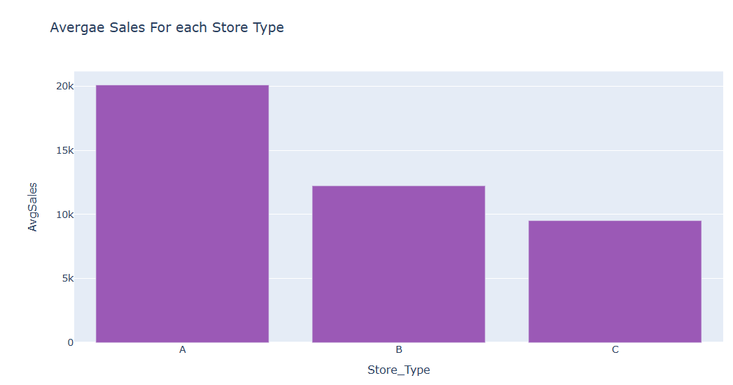
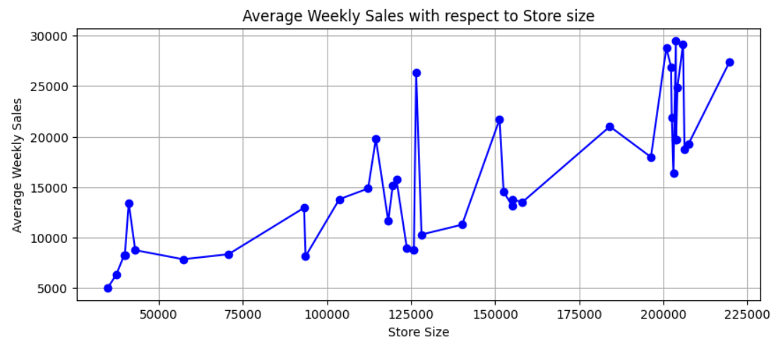
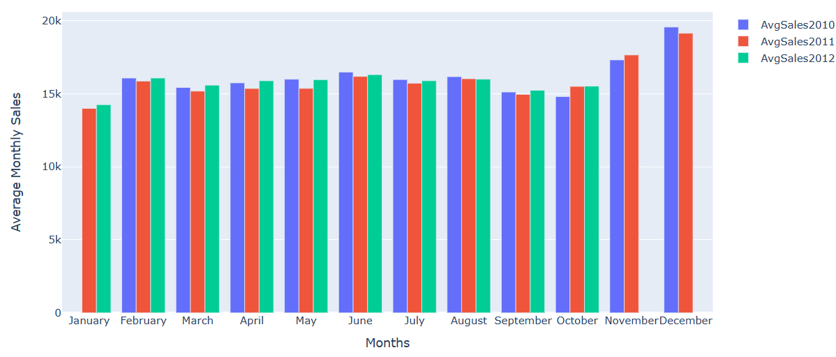
Exploratory Data Analysis
Average Sales For Each Store Type
Average Weekly Sales with Respect to Store Size
Average Monthly Sales
DATA-230 Project Presentation
Predicting Walmart Sales

Slide 9
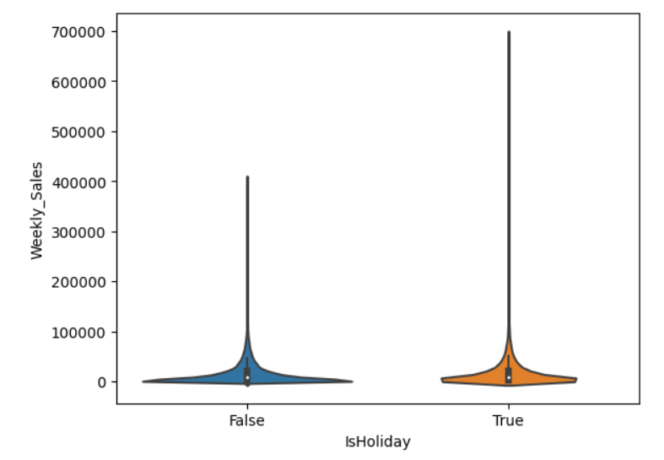
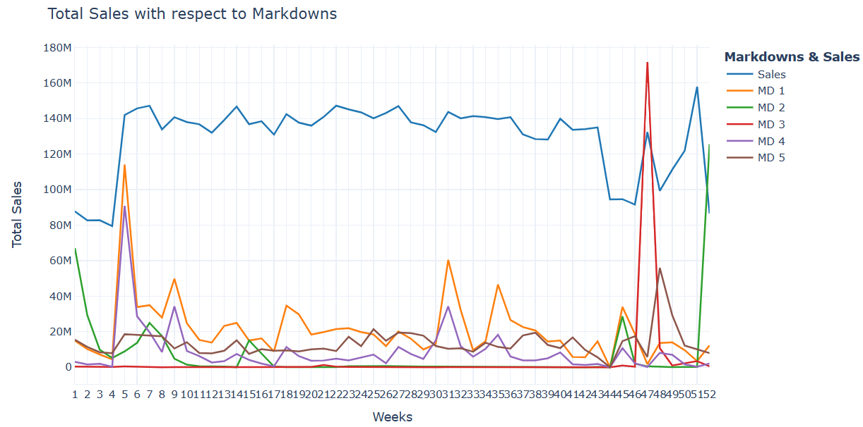
Exploratory Data Analysis
Weekly Sales With Respect to Holiday
Total Sales With Respect to Markdowns
Holiday weeks are only 7% of the data's weeks
Markdowns aid in stabilizing and regaining sales at the start and end of the year
DATA-230 Project Presentation
Predicting Walmart Sales

Slide 10
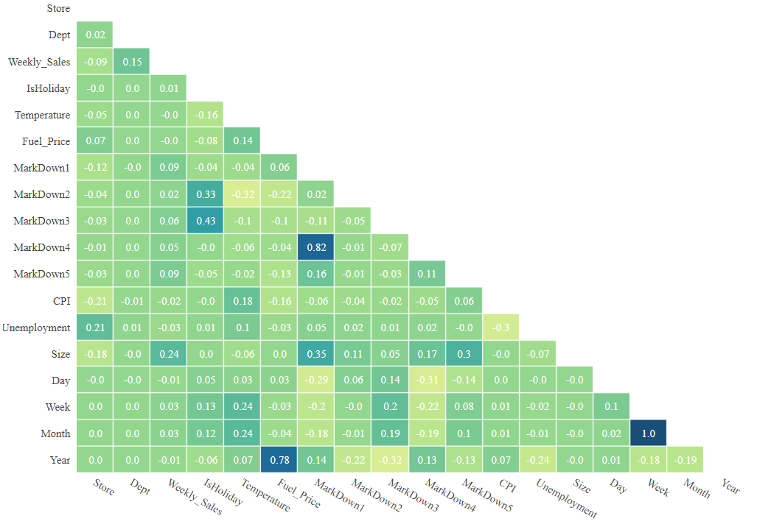
Exploratory Data Analysis (Relationship Between Attributes)
DATA-230 Project Presentation
Predicting Walmart Sales

Slide 11
Feature Engineering
To analyze and gain a deeper grasp of the data, feature engineering is done before exploratory data analysis (EDA).
Six new columns—Year, Month, Month_name, Week_of_year, Day, and Day_Name are extracted from the dataset's "Date" column.
Following column extraction, 421570 rows and 22 columns make up the dataset.
DATA-230 Project Presentation
Predicting Walmart Sales

Slide 12
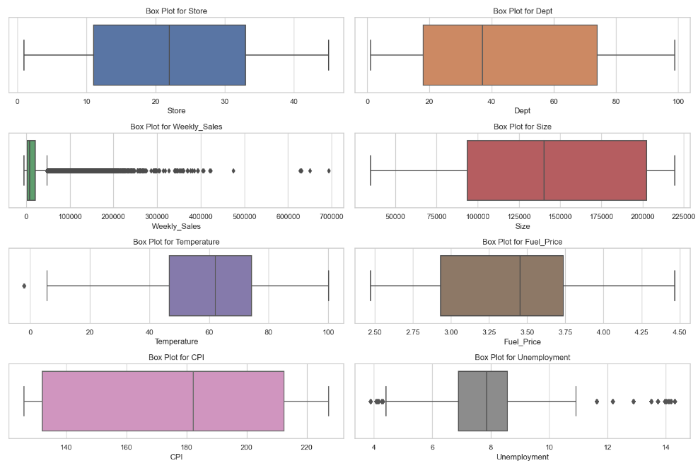
Data Preprocessing
Categorical data IsHoliday and Type column are encoded.
Due to a large percentage of missing values, markdown columns are removed.
During feature engineering, columns that were extracted are eliminated.
Outliers are investigated and eliminated.
Data Split 70:20:10
DATA-230 Project Presentation
Predicting Walmart Sales

Slide 13
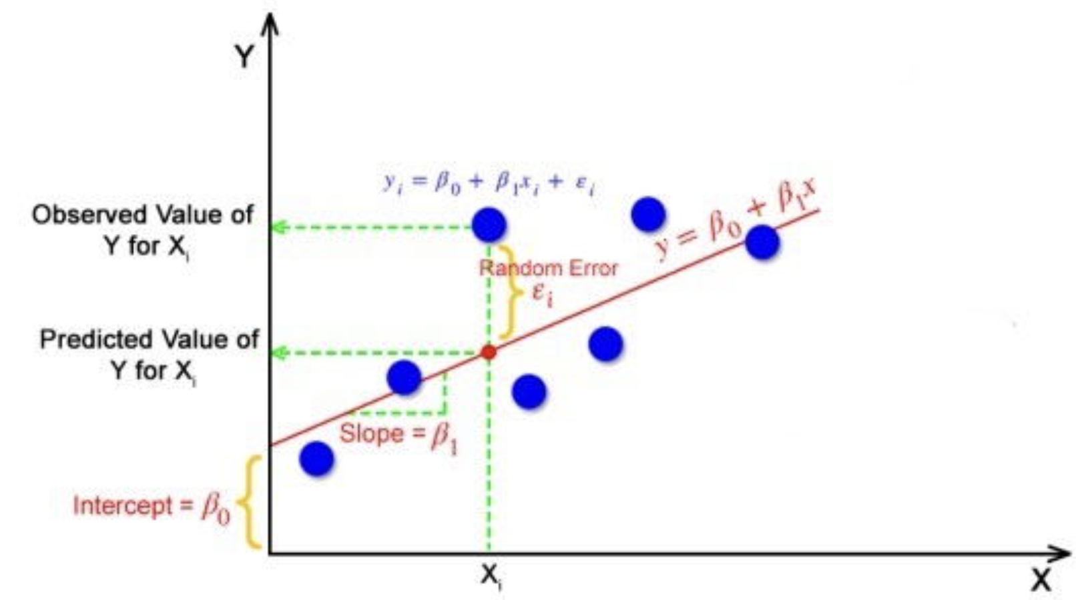
Modelling (Linear Regression)
A statistical technique for simulating the connection between a dependent variable
Multiple linear regression involves two or more independent variables
Y = mx + b
Y = b0+b1x1+b2x2+ ………bnxn
DATA-230 Project Presentation
Predicting Walmart Sales

Slide 14
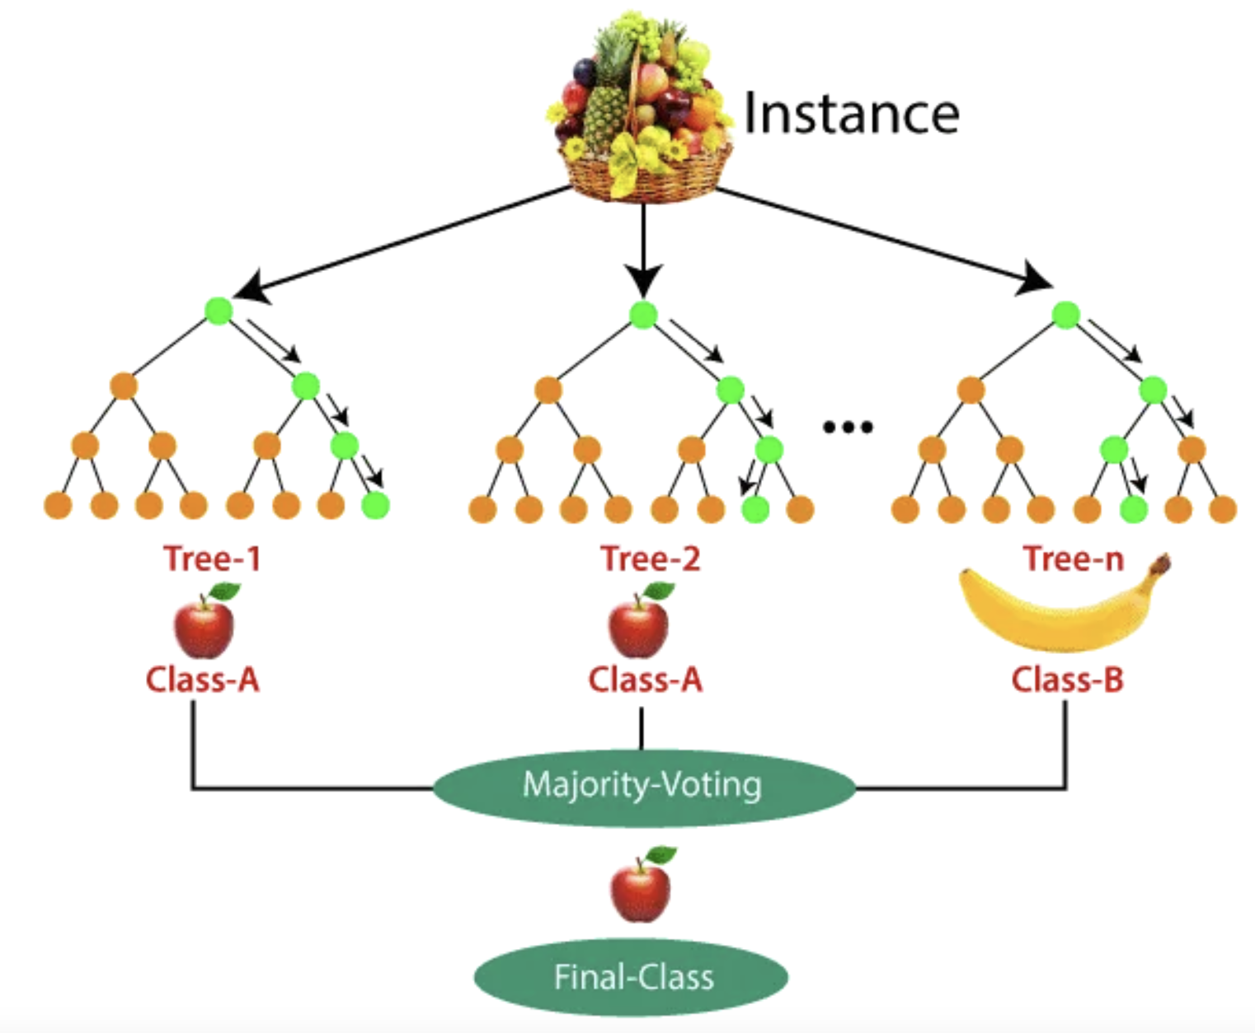
Modelling (Random Forest)
Multiple decision trees are constructed using Bootstrap Sampling
Every tree is trained on a different sample of the data, a method called bagging adds variety to the individual models
The Random Forest uses voting in classification tasks or averaging in regression tasks to blend the outputs
DATA-230 Project Presentation
Predicting Walmart Sales

Slide 15
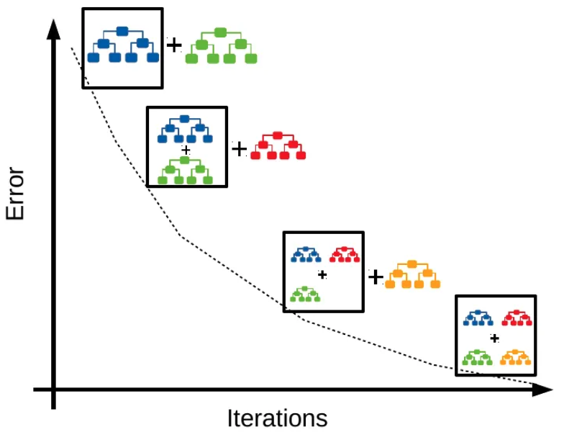
Modelling (Gradient Boost)
Set the target outcomes for next model in order to minimize the error
The name "gradient boosting" comes from the optimization process used
The learning rate is a crucial hyperparameter that determines the step size in the optimization process.
A weak learner to make predictions
DATA-230 Project Presentation
Predicting Walmart Sales

Slide 16
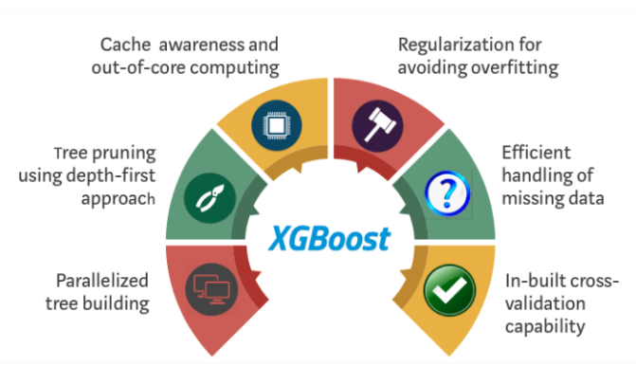
Modelling (XG Boost)
DATA-230 Project Presentation
Predicting Walmart Sales

Slide 17
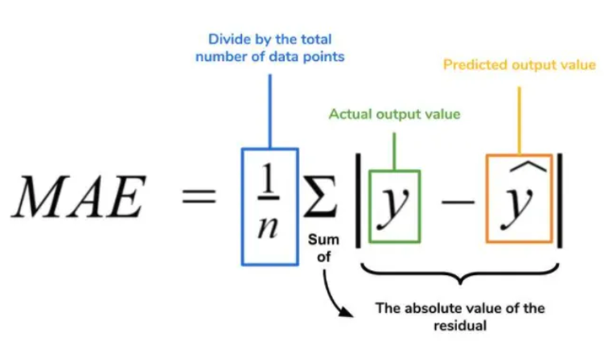
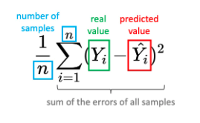
Evaluation Metrics
Mean Squared Error (MSE)
Mean Absolute Error (MAE)
DATA-230 Project Presentation
Predicting Walmart Sales

Slide 18
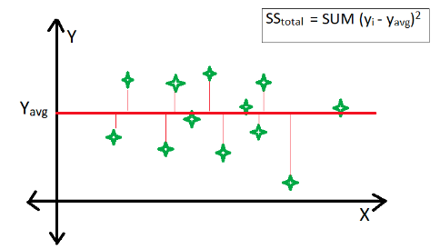
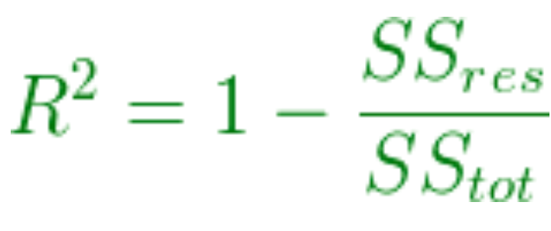
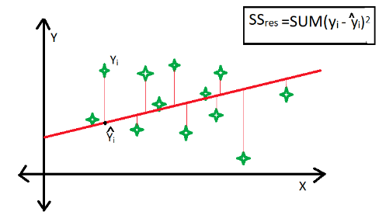
Evaluation Metrics
R-squared (R2) score
DATA-230 Project Presentation
Predicting Walmart Sales

Slide 19
Evaluation (Performance Comparison)
Model | MAE | MSE | R2 Score
Linear Regression | 421599.43 | 257002398384.23 | 15.45
Random Forest | 65999.91 | 14080985096.68 | 95.37
Gradient Bossting Machine | 123013.92 | 27562364717.25 | 90.93
XGBoost Algorithm | 51626.36 | 7189589388.47 | 97.63
DATA-230 Project Presentation
Predicting Walmart Sales

Slide 20
Evaluation (Hyperparameter Performance Comparison)
Model | Hyperparameter | Value Used | Best Hyperparameter value | Accuracy
Linear Regression | Polynomialfeatures__degree | 2,3,4 | 3 | 38.8
Random Forest | n_jobs | -1 | -1 | 95.4
 | max_depth | np.arange(2,15) | 14
 | n_estimators | np.arange(25,101,25) | 50
Gradient Boost | n_jobs | -1 | -1 | 97.48
 | max_depth | np.arange(2,15) | 10
 | n_estimators | np.arange(25,101,25) | 60
XG Boost | n_jobs | -1 | -1 | 97.63
 | max_depth | np.arange(2,15) | 5
 | n_estimators | np.arange(25,101,25) | 180
DATA-230 Project Presentation
Predicting Walmart Sales

Slide 21
Discussion
Linear Regression:
It models the relationship between the dependent variable and one or more independent variables by fitting a linear equation to the observed data.
Linear regression is sensitive to outliers and can overfit the training data if not regularized.
Random Forest:
Random forest is an ensemble method that combines multiple decision trees to make predictions.
Random forests are robust to outliers and can handle complex nonlinear relationships.
DATA-230 Project Presentation
Predicting Walmart Sales

Slide 22
Discussion
Gradient Boosting Machine (GBM):
GBM is an ensemble method that builds a series of decision trees in a sequential manner. Each tree focuses on correcting the errors made by the previous tree, leading to a more accurate overall model.
GBM is similar to random forest but can handle more complex nonlinear relationships and is less prone to overfitting.
XGBoost Algorithm:
XGBoost is an optimized version of GBM that utilizes a more sophisticated approach to tree splitting and regularization.
It is highly accurate and efficient, making it a popular choice for various machine learning applications.
DATA-230 Project Presentation
Predicting Walmart Sales

Slide 23
Conclusion and Future Scope
This analysis examined multiple machine learning methods for more accurately forecasting the sales data from 45 Walmart stores.
The performance of linear regression, random forest, gradient boosting machines, and XGBoost algorithms are compared. XGBoost emerged as the best approach with the lowest error rates and highest R2 score of 97.63%.
The Ensemble methods handled nonlinear sales patterns well and prevented overfitting through built-in regularization.
Further analysis into feature importance and effects could improve business understanding.
The models could also be retrained periodically using updated sales data to maintain accuracy over time.
Integration of these forecasts into inventory management and supply chain systems would fully realize their business value
DATA-230 Project Presentation
Predicting Walmart Sales

Slide 24
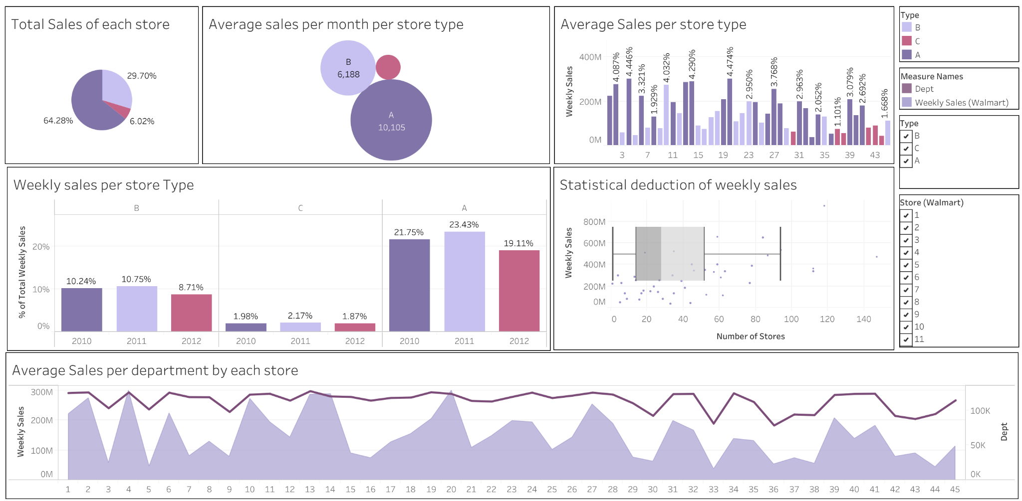
Tableau Dashboard
Walmart Dataset Dashboard

Slide 25
References
https://www.google.com/imgres?imgurl=https%3A%2F%2Fmiro.medium.com%2Fv2%2Fresize%3Afit%3A560%2F1*85QHtH-49U7ozPpmA5cAaw.png&tbnid=lItU_AQMxMMBuM&vet=10CAwQxiAoBWoXChMIsNKTg9viggMVAAAAAB0AAAAAEAY..i&imgrefurl=https%3A%2F%2Fmedium.com%2Fanalytics-vidhya%2Fwhat-is-gradient-boosting-how-is-it-different-from-ada-boost-296f055ecacd&docid=QUrBBPfy8RqHpM&w=560&h=309&itg=1&q=gradient%20boost%20vs%20xgboost&ved=0CAwQxiAoBWoXChMIsNKTg9viggMVAAAAAB0AAAAAEAY#imgrc=lItU_AQMxMMBuM&imgdii=3k8QU1bP4Qx43M
https://suboptimal.wiki/explanation/mse/
https://medium.com/@polanitzer/the-minimum-mean-absolute-error-mae-challenge-928dc081f031
https://www.geeksforgeeks.org/ml-r-squared-in-regression-analysis/
https://www.google.com/url?sa=i&url=https%3A%2F%2Fwww.kaggle.com%2Fdatasets%2Frutuspatel%2Fretail-analysis-with-walmart-sales-data&psig=AOvVaw2DDHX80o80_8kzcODaj0XB&ust=1701210680465000&source=images&cd=vfe&opi=89978449&ved=0CBEQjRxqFwoTCKjzuOSd5YIDFQAAAAAdAAAAABA0

Slide 26
Thank You
DATA-230 Project Presentation
Predicting Walmart Sales

